Slide 1
Real-Time Analytical Support System for Innovative Visualization Techniques
Jaskeerat Singh
47610039
Notes:
Hello everyone my name is jaskeerat Singh and today I will be showing you my project regarding the development of a real time analytical support system for innovative visualization techniques

Slide 2
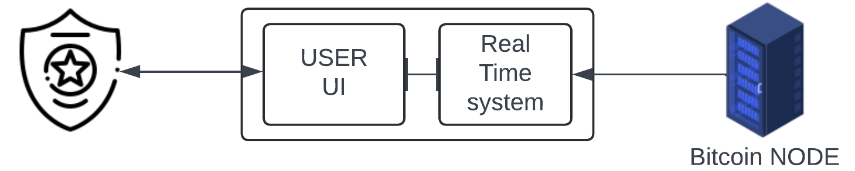
INTRODUCTION
The advancement and widespread adoption of digital currencies have transformed cryptocurrencies into viable alternatives to traditional payment methods. However, this rapid growth has also led to increasingly sophisticated forms of cybercrime in the financial sector.
This increase in the usage of cryptocurrencies for cybercrime prompts a need for a real-time system to detect and monitor anomalous transactions. Such a system can help law enforcement agencies uncover the complex network of fraudulent transactions in real-time by enabling users to detect and visualize a transactions sequence of motion to their origin.
Notes:
We all know that the widespread adoption of digital currencies is a boon for cryptocurrencies as they have now become a viable alternative to traditional payment methods. but because of this advancement it has also led to an increase in different forms of cybercrime and this increase in crime prompts a need for a real time system that can help detect and monitor anomalous transactions. such a system can help law enforcement agencies visualize anomalous transactions and where they’re coming from.

Slide 3

Project Overview
The entire project consisted of 4 parts –
Connection to the Bitcoin RPC server
Preprocessing the incoming data in real-time
Conducting fraud analysis on the incoming transactions
Development of a user-interactive visualization
My Contribution
Built an analytical pipeline that help move the data from the source to the destination
Incorporate and connect different parts of the project as one to provide seamless data flow between the different components
Provide latency free experience as well as reduce load on the client side
Notes:
This project basically consists of four different parts 1st is the connection to the Bitcoin RPC server 2nd is the processing of the incoming data 3rd is the fraud analysis and 4th is the development of a user UI for visualization.
In this project my aim was to build a analytical pipeline that helps move the data from source to destination but also help incorporate and connect different parts of this project while providing A latency free experience to the client side

Slide 4
Related Work
Pham and Lee (2016) explored anomaly detection in the Bitcoin network using different unsupervised learning methods. Their study aims to identify suspicious users and transactions by applying different unsupervised learning methods such as k-means clustering, Mahalanobis distance, and Unsupervised Support Vector Machines (SVM).
In the paper by Monamo, Marivate and Twala (2016), the authors proposed the use of trimmed k-means clustering for detecting fraudulent activities in Bitcoin transactions. Their work demonstrated the effectiveness of trimmed k-means in identifying a higher number of fraudulent transactions in the same dataset than compared with other existing work, thus enhancing the robustness of anomaly detection in the Bitcoin network.
Chan and Olmsted (2017) proposed the implementation of Neo4j to model transactions in Ethereum blockchain as a graph. This enabled the use of complex queries and analytics to gain insights into transactional patterns and connections. This approach used the capabilities of Neo4j to uncover potential de-anonymization vectors within the blockchain.
Al-Hashedi et al. (2023) discussed about the integration of Neo4j graphical database to manage and link vast amounts of transaction data. This integration helped in efficiently organizing relationships between users, transactions, and addresses, which aided to the data preparation process for fraud detection.
Notes:
And these are some of the related works that we have used and build upon in the first two papers there is a discussion about how different unsupervised machine learning methods behave and identify fraudulent activities in Bitcoin transactions the last two papers discuss the use of neo 4J as a graph database and how its abilities of handling complex queries helps in faster retrieval and storage of data

Slide 5
Problem Definition
Develop a real-time analytical system equipped with advanced anomaly detection methods to identify and analyze suspicious transactions. This system should not only efficiently process and store data but also ensure its availability with minimal latency.
Notes:
Now comes the main problem definition, we have to develop a real time analytical system which is capable off using advanced anomaly detection methods to identify and analyse suspicious transactions. this system should not only efficiently process and store data what also ensure that it is available with minimal latency

Slide 6
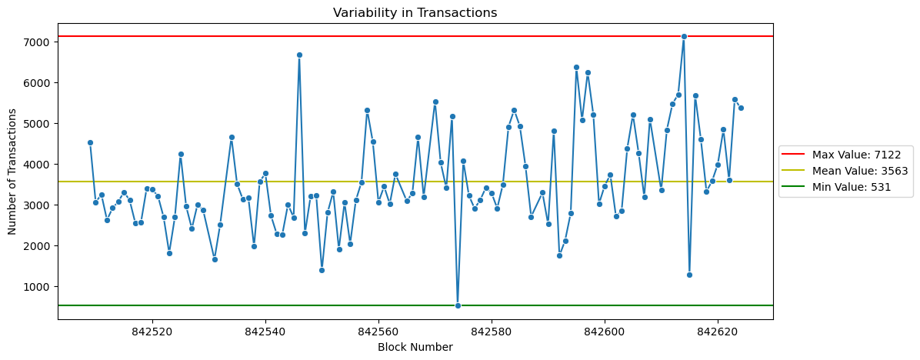
Finding and Defining Constraints
We did analysis on the incoming data to identify and define a set of constraints under which we should design the solution. For the analysis, we collected more than 100 consecutive blocks of bitcoin data from the Bitcoin node RPC Server.
Size Variability
Notes:
Before we define our goals and tasks we will look at the set constraints under which we should work
To do this analysis we collected more than 100 consecutive blocks of Bitcoin data
first one is size variability In this analysis –
We can see that number of transactions in a block fluctuate and there is not a defined range of transactions in a block
The number of transactions can be as low as 531 or as high as 7122

Slide 7
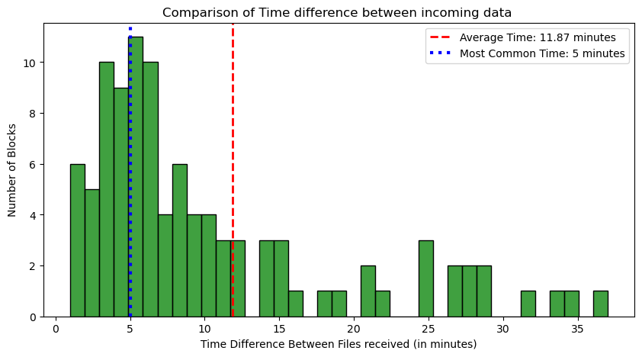
Time Variability
The average time it takes for a new block to become available is approximately 11 to 12 min
In most cases, new data becomes available to the user every 5 min.
Notes:
Second is time variability.
Here, we had to find and define a time window under which new data becomes available.
The average time it takes for a new block to become available is approximately 11 to 12 min

Slide 8
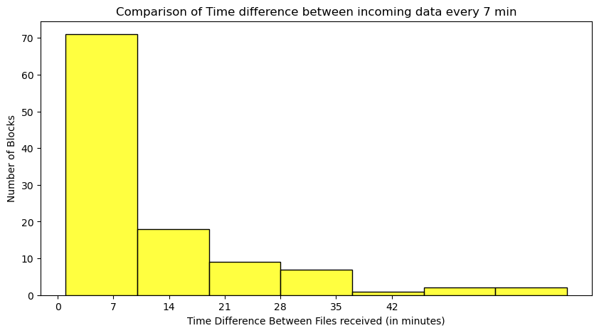
A large number of blocks becomes available every 7-8 min.
From the histogram, we can see that approximately 70% of the blocks follow this pattern .
Notes:
From the histogram, we can see that approximately 70% of the blocks become available every 7 to 8 minutes

Slide 9
Defining Goal
Through Source analysis, we decided a set of tasks that needed to be completed based on the constraints defined.
Tasks
Complete ETL process in 7 min
Clean and standardize incoming data.
Find anomalous data using unsupervised ML
Storage of incoming data according to a predefined schema.
Integrate Yifan’s Supervised ML model to generate alerts
Rest API to make data available to end user
Constraints
Data received is in nested json format
Size Variability
Time Variability
Non scalable system
Notes:
Based on these constraints we define a set of tasks
1st we have to make sure that the process is completed in 7 minutes
2nd we have to clean and process the incoming data
3rd we have to find anomalies using unsupervised machine learning methods
4th is the storage of the incoming data
5th is the integration of yifans supervised machine learning model to generate alerts
and at last is the development of a rest API to make data available to the end user
all of these tasks need to be completed while taking these constraints into consideration

Slide 10
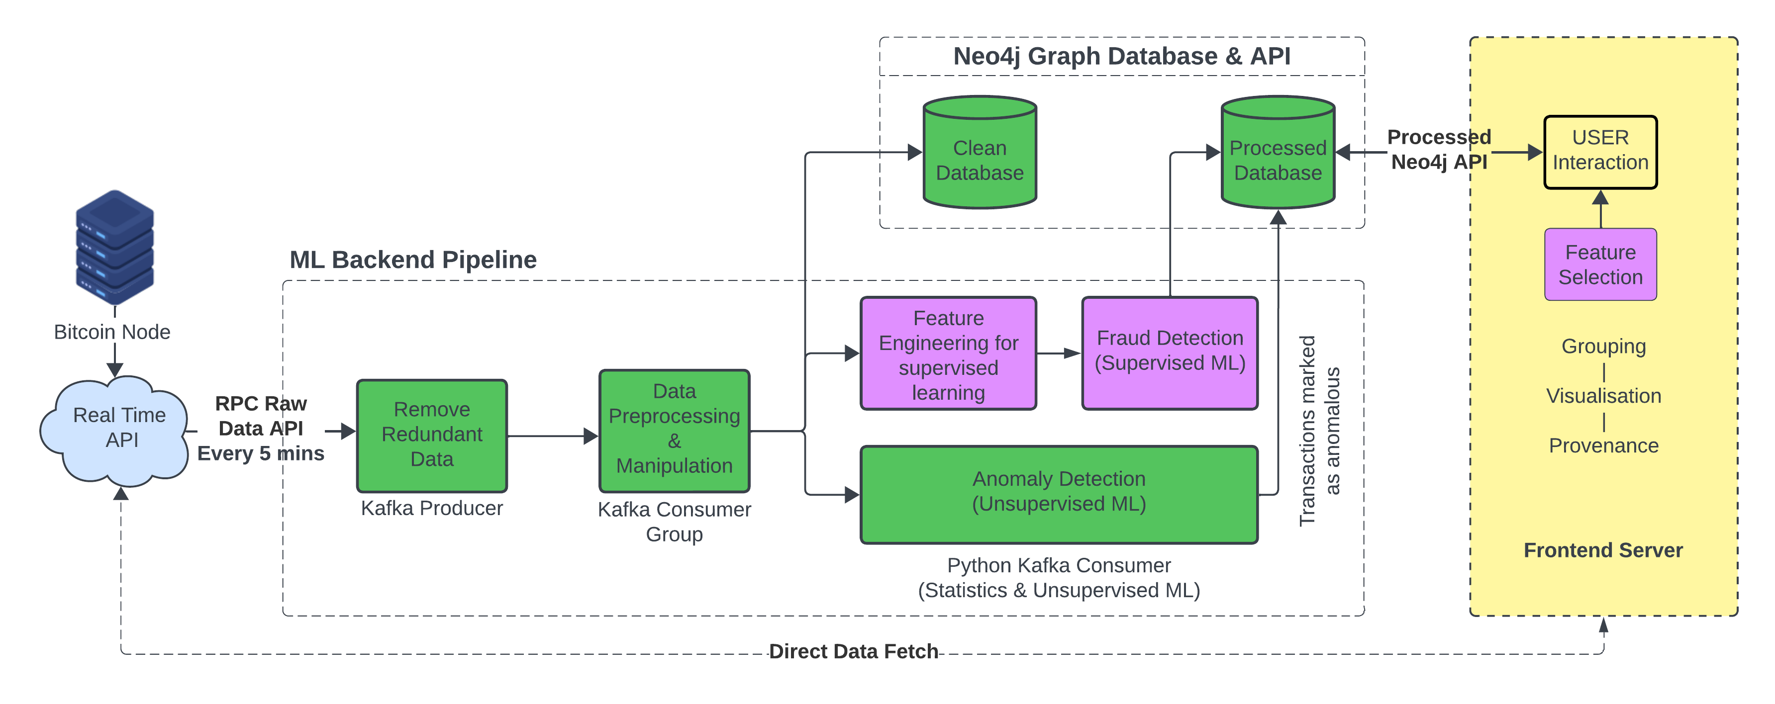
Proposed Solution
Notes:
After careful deliberation and discussions, a solution architecture was defined that addresses the tasks and operates within the constraints. This architecture outlines the data flow between the components.

Slide 11
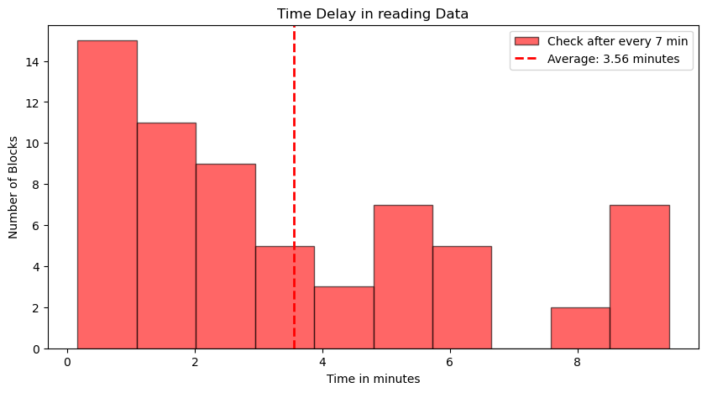
Data Source Analysis
CHALLENGE 1
If we try to read the data every 7 min using the API, we can expect a time delay of approximately 4 min between when the data became available and the moment it was fetched.
Notes:
Coming to challenge #1 if you try to read the data every 7 minutes using the API we expect a time delay of approximately 4 minutes between when the data becomes available and the moment it was fetched

Slide 12
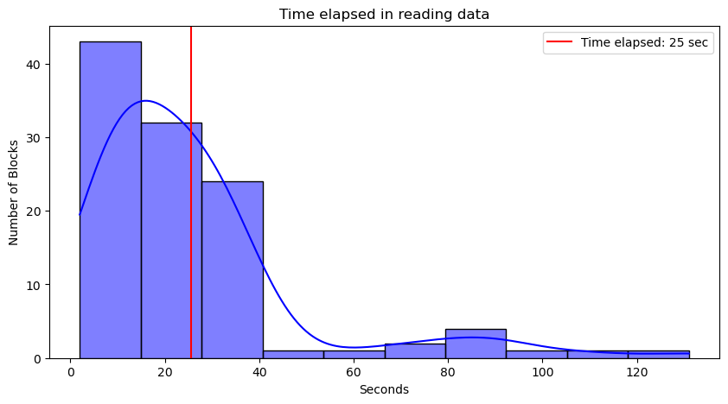
Solution
Modify the code for fetching the data and introduce a variable time frame.
Data is fetched every 1 min, If same block is returned then check every 30 sec
Time delay reduced to 25 sec
Notes:
To reduce this time discrepancy we modified the code for fetching the data and introduced a variable time frame
This was done to reduce load on Utkarsh’s API if we call it every 1 sec.
Through this we were able to reduce the time to 25 seconds

Slide 13
Storage Analysis
For storing our pre-processed data, we had to choose a solution that fulfilled our project requirements
Fast read and write capabilities
Able to handle Big Data
Able to merge with a real-time system
Scalable and able to handle data updates without issues.
Feature | SQL Database (MySQL) | NOSQL Database (Neo4j)
Read Performance | Join operations ↑ read performance ↓ | No join operations Relationships are stored
Write Performance | Ease of handling big transactions | Relationship complexity ↑ write performance ↓
Schema Update | Rigid Schema | Highly flexible
Join Queries | Complexity of joins ↑ Join performance ↓ | No need of join
Scalability | Vertically scalable | Horizontally scalable
Notes:
Next comes is the storage of our preprocessed data. we have to select a database which is fast for both reading and writing, is able to handle big data and can integrate well with the real time system.
we considered a MySQL database and a neo4j database. we chose neo4J over mysql because of its highly flexible nature, no need of making joins in queries as joins are saved as relationship inside the database as well as this system is horizontally scalable.

Slide 14
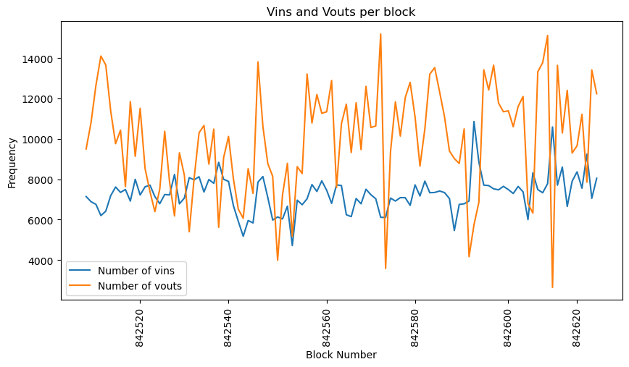
CHALLENGE 2
Vin and Vout define the money flow through a bitcoin node.
Vin define the sub-transaction (money) coming from an address
Vout define sub-transaction (money) going out to an address.
Notes:
To check out the performance of the two databases, I measured the amount of Vin’s and the vouts in a block
Vin defines the money coming from an address while vout define the money going to an address
Number of Vin’s and Vout’s are very high per block

Slide 15
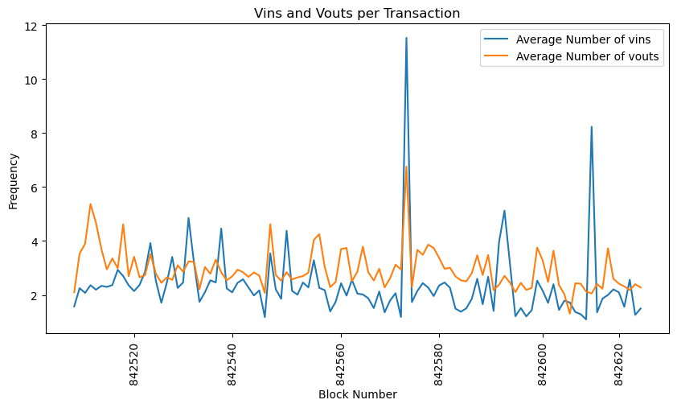
Solution
Loaded both Neo4j and MySQL database with 100 blocks of data.
Read Transaction - “0372b2d0c9c5386068120eaf411f181639ad56b3fc76ba6bef655ceb858ff882” with 229 Vin’s and 456 Vout’s
METRICS
Time of Retrieval (Not Indexed / Indexed)
Neo4j – 2.8 seconds / 8 milli seconds
MySQL – 3.6 seconds / 16 milli seconds
Notes:
The average number of Vin’s and Vout’s per transaction lie around 4 and 5 respectively
Here we can see that I have chosen a particular transaction with high number of vins and high number of the vouts.
from the metrics we can see that neo4j is faster in returning the results.

Slide 16
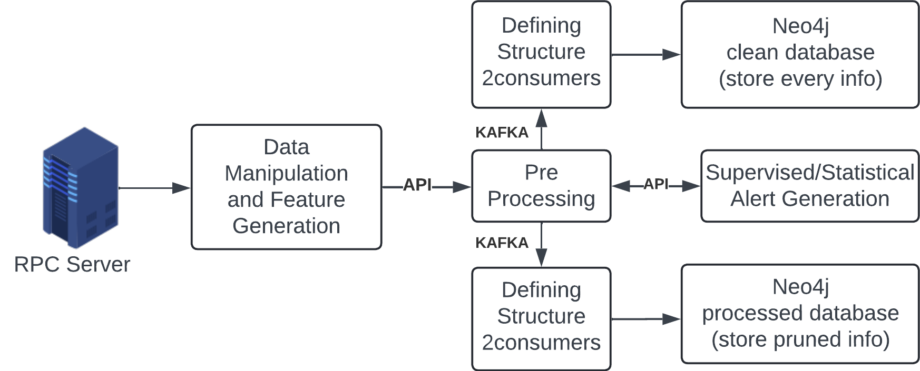
KAFKA - Pub Sub Delivery
CHALLENGE 3
After the data has been received from the API, we need to pass it across three different processes –
Storage into Clean Database
Storage into Processed Database + Supervised ML
Anomaly Detection (unsupervised ML)
Notes:
After the data has been received from the API we need to pass it across three different processes.
1st we need to store the data in the clean database
2nd we need to store the data in processed database after the alert has been generated using yifans supervised machine learning model
and 3rd for anomaly detection

Slide 17
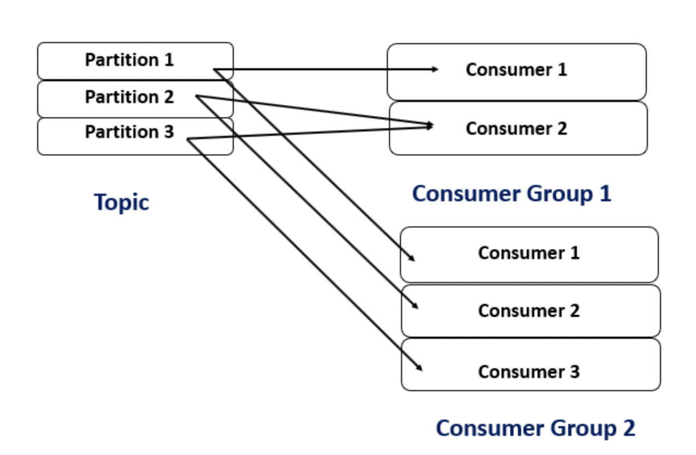
KAFKA - Pub Sub Delivery
Passing the same data across the 3 separate systems one by one when there is a lot of variability like time variance, size variance and non scalable system causes a lot of overhead work.
To mitigate this, we decided to use KAFKA which handles parallel processing, automatic distribution of work, delivery of data and connection to different systems.
Notes:
Keeping in mind the constraints, we chose kafka because of it abilities to handle parallel processing, automatic distribution of work, reliable delivery of data and the ability to connect to different systems.

Slide 18
KAFKA Clean Consumer Analysis
After the data has been received from the API, we needed to pre-process and store the data according to the defined relationship schema and store every information in the Neo4j. Our aim was to store data in the block under 7 min.
Performance Testing
We considered the largest block of data consisting of approximately 7300 transactions.
The analysis was done on a machine with 8 cores and 16gb of ram. At ideal it had a CPU usage of 10% with a ram usage of 9gb
Base Run
The process took approximately 5 min 50 sec to push data into neo4j. The CPU usage was 40% with 9.5gb ram usage.
Problem Definition – Challenge 4
In our defined system, the whole list of incoming transactions should have been processed from fetching through API to unsupervised analysis in 7 min. These block of transactions were itself taking 5min 50sec.
Notes:
After the data has been received from the API we need to store it in our neo4j database. Our aim is to complete everything in under 7 minutes.
To do the performance testing we chose the largest block of data consisting of 7300 transactions. For our analysis I’m using a system which comes with eight cores and 16GB of ram.
At idle the CPU usage hovers around 10% while ram usage is 9 GB. in the base run we can see that the process took approximately 6 minutes to push data into neo4J the CPU usage went up to 40% with 9.5 GB ram usage.
here comes our challenge 4, the system is taking a lot of time close to 6 minutes why we need to complete everything in under 7.

Slide 19
Proposed Solution - To reduce the time limit, various techniques were tested:
Parallel processing - Increasing number of KAFKA consumers in the consumer group
Code & Query optimization – Combining creation and relationship Queries
Indexing – Creating index on transaction, block and address nodes in neo4j
Method (Average of 5 runs) | Consumers | Time | CPU Usage | RAM Usage
Basic Queries | 1 | 5min 50sec | 40% | 9.5GB
Basic Queries | 2 | 3min 20sec | 55% | 9.6GB
Basic Queries | 4 | 1min 50sec | 85% | 9.8GB
Optimized Code & Queries | 1 | 5min 10sec | 35% | 9.4GB
Optimized Code & Queries | 2 | 2min 40sec | 50% | 9.4GB
Optimized Code & Queries | 4 | 2min 10sec | 80% | 9.7GB
Optimal Solutions
Method | Consumers | Time | CPU Usage | RAM Usage
Optimized Code & Queries with indexing And compact schema | 2 | 45sec | 50% | 9.8GB
Optimized Code & Queries with indexing | 2 | 1min 40sec | 55% | 9.9GB
Notes:
To mitigate the issues I propose a combination of 3 different techniques –
parallel processing
query optimizations and
indexing
this table represents an average of five runs. from the table you can see that there is not much effect on the ram usage but the CPU usage becomes very high as number of parallel consumer increases. the optimal solution use only two parallel processes usage remains close to 50% the ram usage is also not very high and the time is reduced to under one minute

Slide 20
KAFKA Processed Consumer Analysis
After the data has been received from the API, we needed to pre-process, produce alerts and store the data according to the defined relationship schema and store only relevant information in the Neo4j. Our aim was to store data in the block under 7 min.
Performance Testing
We considered the largest block of data consisting of approximately 7300 transactions.
The analysis was done on a machine with 8 cores and 16gb of ram. At ideal it is having a CPU usage of 10% with a ram usage of 9gb
Base Run
The process took approximately 5 min 20 sec to push data into neo4j. The CPU usage was 40% with 9.5gb ram usage.
Problem Definition – Challenge 5
In our defined system, the whole list of incoming transactions should have been processed from fetching through API to unsupervised analysis in 7 min. These block of transactions were itself taking 5 min 20sec.
Notes:
Same as done for the clean database. After the base run we can see that the system takes close to 5 and a half min to process everything.

Slide 21
Proposed Solution - To reduce the time limit, various techniques were tested:
Parallel processing - Increasing number of KAFKA consumers in the consumer group
Pruning: Keeping only the required data as discussed with Yifan and Jisung
Indexing – Creating index on transaction, block and address nodes in neo4j
Method (Average of 5 runs) | Consumers | Time | CPU Usage | RAM Usage
Basic Queries (no pruning and all relationships) | 1 | 5 min 20 sec | 40% | 9.6GB
Basic Queries (pruning and no relationship) | 1 | 2 min 50 sec | 45% | 9.6GB
Basic Queries (pruning and no relationship) | 2 | 1 min 40 sec | 65% | 9.6GB
Basic Queries (pruning and no relationship) with indexing | 2 | 1 min 30 sec | 65% | 9.6GB
Optimal Solutions
Method | Consumers | Time | CPU Usage | RAM Usage
Basic Queries (pruning and no relationship) with indexing | 2 | 1 min 30 sec | 65% | 9.6GB
Notes:
To mitigate the issues I propose a combination of 3 different techniques –
parallel processing
Pruning – keeping only required data and
indexing
this table represents an average of five runs. from the table you can see that there is not much effect on the ram usage but the CPU usage becomes high as number of parallel consumer increases. the optimal solution use only two parallel processes usage remains close to 65% the ram usage is also not very high and the time is reduced to one minute and 30 sec

Slide 22
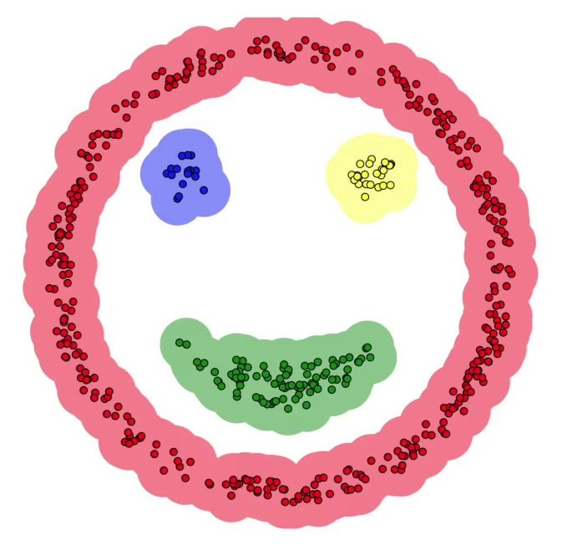
Anomaly Detection
Our objective was to incorporate an ml model that looked for anomalous transactions in the incoming data in real-time.
Problem Definition - Challenge 6
Keeping in mind all the constraints like the time variability, size variability and unscalable system plus the unavailability of large amount of labelled data made it unfeasible for us to incorporate any supervised machine learning algorithm for anomaly detection
Solution
Looked for unsupervised machine learning algorithm and decided to incorporate a clustering based mechanism
DBSCAN
Automatically detect number of clusters
Efficient training times over a large sample of data
Form clusters of arbitrary shapes rather than only forming spherical clusters
Small numbers of hyperparameters – EPS and MinPoints
Notes:
After KAFKA Producer made the data available for anomaly detection. we tried to incorporate a different machine learning methods but keeping in mind the different constraints and the unavailability of large amount of label data made it impossible for us to incorporate any supervised machine learning models.
Then, we tried to look into different unsupervised machine learning algorithms and after discussion incorporated a clustering based mechanism that is DBSCAN.
some of the advantages of DBSCAN is that –
it can automatically create a number of clusters,
it is efficient in training over large samples of data,
it can form clusters of arbitrary shapes and
ithas a very small number of hyperparameters

Slide 23
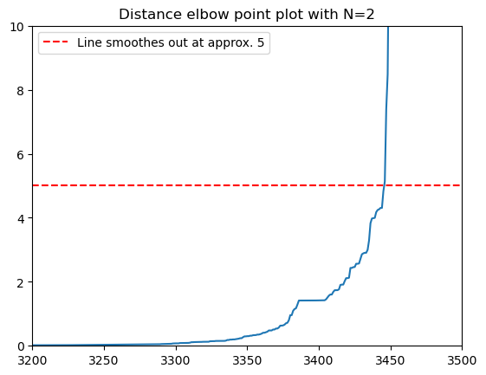
Hyper Parameter Tuning
We took an average block of data consisting of approximately 3500 transactions
Defined a grid search method to search for different combinations of hyper parameters
Calculate silhouette score that lies in the range [-1,1]
Min Points normally set in the range of [number_of_features + 1, number_of_features*2]
Range of EPS - Distance plot
Notes:
Coming to hyperparameter tuning.
for this analysis we chose an average block containing approximately 3500 transactions.
For minimum point hyperparameter, it is a best practice to select a value which lies in the range off number of features plus one, number of features into 2
Four EPS hyperparameter, we plotted the distance plot from the graph we can see that the line straightens after approximately 5 so we will choose a range of 0 to 5
We then defined a grid search method to find silhouette score based on different combinations of the hyperparameter.
Then silhouette score was calculated

Slide 24
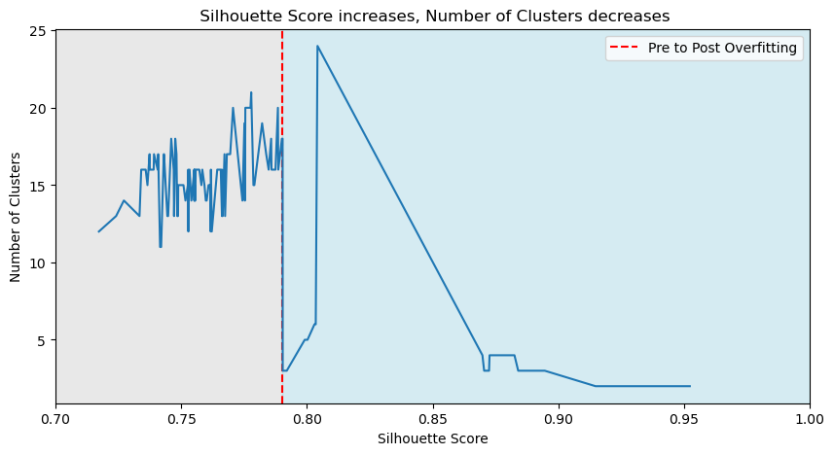
Post Grid Search
Silhouette Score assess the quality of clustering
Defines how similar an object is to its own cluster compared to other clusters
As the Silhouette Score increases the number of clusters decreases which is a clear sign of overfitting
Notes:
Silhouette score assess the quality of clustering.
It defines how similar an object is to its own cluster compared to other clusters.
From the graph we can see that as the silhouette score increases the number of clusters decreases. this is a sign of overfitting

Slide 25
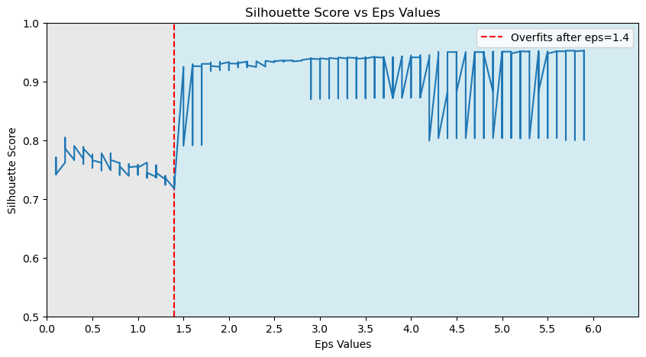
Post Grid Search How EPS hyper parameter is affected?
At value above 1.4, it starts to overfit where silhouette score reaches very close to 1
Notes:
Now for EPS, we measured and plotted the silhouette score.
EPS is the maximum distance between two samples for them to be considered as in the same cluster.
From the graph we can see that at a value off 1.4 and above the model overfits and the score becomes close to 1.
so we will choose a value of EPS from zero to 1.4

Slide 26
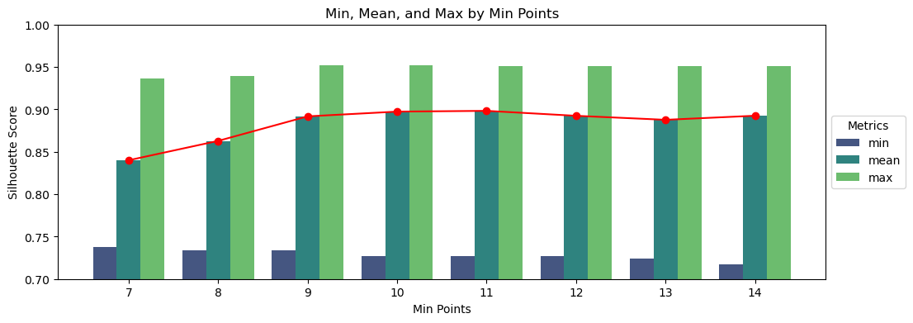
Post Grid Search How Min Points hyper parameter is affected?
At value above 8, it starts to overfit where even the mean silhouette score lies between 0.9 and 1
Notes:
Now for min points, we plotted the mean silhouette score.
min points specifies the minimum number of points required to form a cluster.
We can see, that after 8 it starts to overfit as silhouette score lies between 0.9 and 1

Slide 27
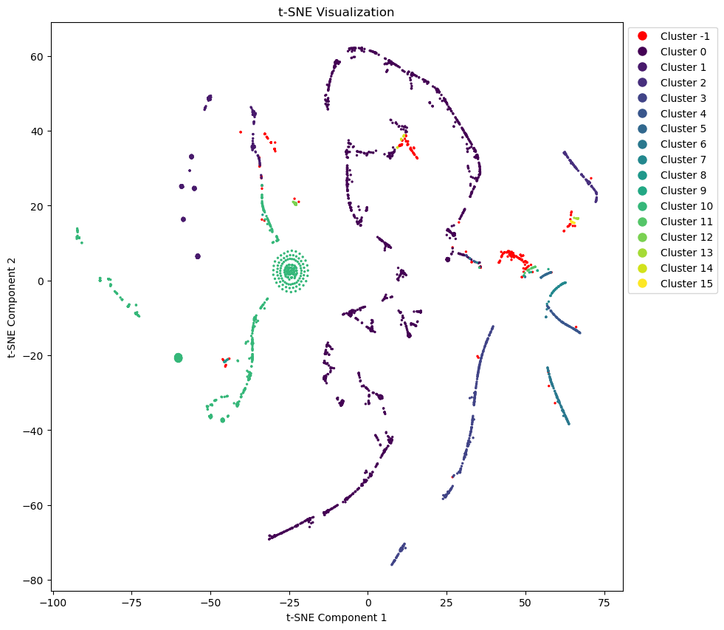
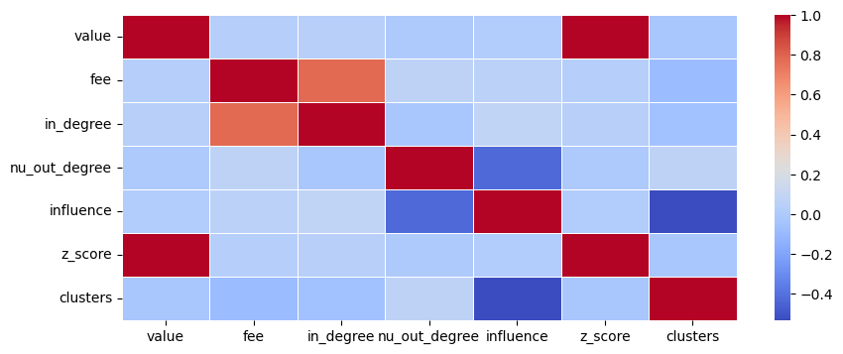
Post Grid Search
Min Points = 8
eps between [0, 1.4]
Choosing combination of Min points and eps forming large number of clusters
eps = 0.6, Min Points = 8, forms 17 Clusters
Cluster Formation is affected most by the –
Influence
in_degree
Fee
Value
Notes:
Hence after grid search and analysis, the value of EPS is chosen to be 0.6, minimum point to be 8 on these.
On these values the number of clusters is 17.
From the visualization on the left we can see that anomalous points are assigned to -1.
For this visualization we performed TSNE which converts higher dimension features into lower dimension. The two best lower dimension features were then plotted.
From the visualization on the right, we can see that the cluster formation is affected most by the influence, then comes the in degree, then fees and value.

Slide 28
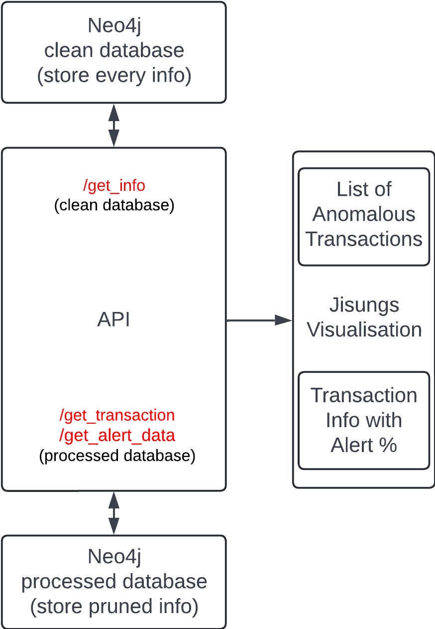
Rest API
REST API used to transfer data between backend and USER UI
Developed to treat user as a thin client
3 endpoints –
get_info – Returns information of a transaction/block
get_transaction – Returns information about transactions vins, vout and alert level
get_alert_data – Returns list of transactions marked as anomalous
Why Rest API?
Considered as an industry standard for building web services
Host of security options like Oauth, HTTPS, SSL/TLS (certificate authority)
Notes:
At the end, processed data becomes available to Jisung using a rest api. The api contains 3 endpoints for his visualization.

Slide 29

DEMO

Slide 30
Conclusion
After thorough analysis and performance testing, we developed a backend system that is fast, reliable and scalable given the constraints and requirements
Implemented a Kafka streaming system to efficiently handle large volumes of incoming data generated by the blockchain, ensuring smooth data flow and processing to other components.
Utilized Neo4j to benefit from the strengths of a graph database by significantly enhancing our ability to handle complex relationships and improving query performance over other traditional systems.
Incorporated the DBSCAN clustering algorithm for real-time anomaly detection, showcasing the effectiveness of unsupervised machine learning techniques in identifying anomalies in cryptocurrency transactions.
By addressing the challenges that come up in the field of cryptocurrency transaction monitoring, the project managed to provides a framework that can be easily modified and adopted for future needs.

Slide 31
References
Pham, T., & Lee, S. (2016). Anomaly detection in bitcoin network using unsupervised learning methods. arXiv preprint arXiv:1611.03941.
P. Monamo, V. Marivate, and B. Twala, "Unsupervised learning for robust Bitcoin fraud detection," in 2016 Information Security for South Africa (ISSA), Johannesburg, South Africa, 2016, pp. 129-134. doi: 10.1109/ISSA.2016.7802939.
W. Chan and A. Olmsted, "Ethereum transaction graph analysis," in 2017 12th International Conference for Internet Technology and Secured Transactions (ICITST), Cambridge, UK, 2017, pp. 498-500. doi: 10.23919/ICITST.2017.8356459.
Al-Hashedi, K.G. et al. (2023). A Supervised Model to Detect Suspicious Activities in the Bitcoin Network. In: Al-Sharafi, M.A., Al-Emran, M., Al-Kabi, M.N., Shaalan, K. (eds) Proceedings of the 2nd International Conference on Emerging Technologies and Intelligent Systems. ICETIS 2022. Lecture Notes in Networks and Systems, vol 584. Springer, Cham. https://doi.org/10.1007/978-3-031-25274-7_53.
Hanae, A. B. B. A. S. S. I., Abdellah, B. E. R. K. A. O. U. I., Saida, E. L. M. E. N. D. I. L. I., & Youssef, G. A. H. I. (2023). End-to-End Real-time Architecture for Fraud Detection in Online Digital Transactions. International Journal of Advanced Computer Science and Applications, 14(6).
D. V. Kornienko, S. V. Mishina, S. V. Shcherbatykh, and M. O. Melnikov, "Principles of securing RESTful API web services developed with python frameworks," in Journal of Physics: Conference Series, vol. 2094, Cybernetics and IT, 2021, 032016. doi: 10.1088/1742-6596/2094/3/032016.

